Slide 1
Analyzing the Unemployment Rate in the United States
IS 597 PRO FA21: Programming for Analytics & Data Processing
Presented by:
Divyaang Agarwal
Ankita Khiratkar

Slide 2
Introduction
What is Unemployment Rate?
Unemployment rate is the fraction of labor force looking for a job.
This project aims to find relation between unemployment rates over the years in the United States and factors like age, ethnicity, education level, etc.
We have also tried to see if unemployment rate is affected by things like GDP, Political party in the power, population and region, etc.
Covid-19 has seen the one of the highest unemployment rate in the history of United States. We have tried to analyze the trend between fall and rise of unemployment during Covid-19 and in the period of Great Recession.

Slide 3
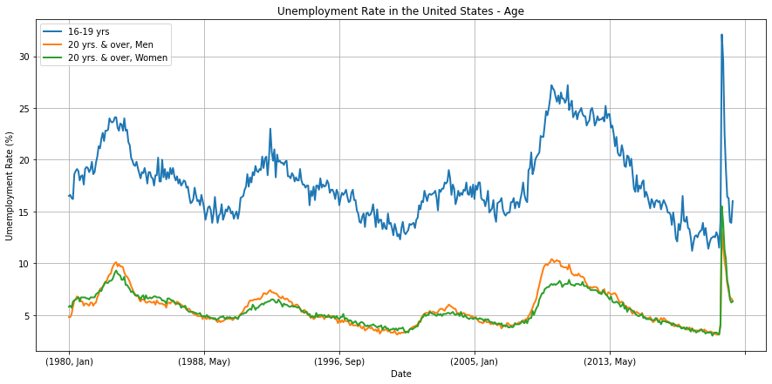
Hypothesis 1: Unemployment rate in the United States is independent of Age

Slide 4
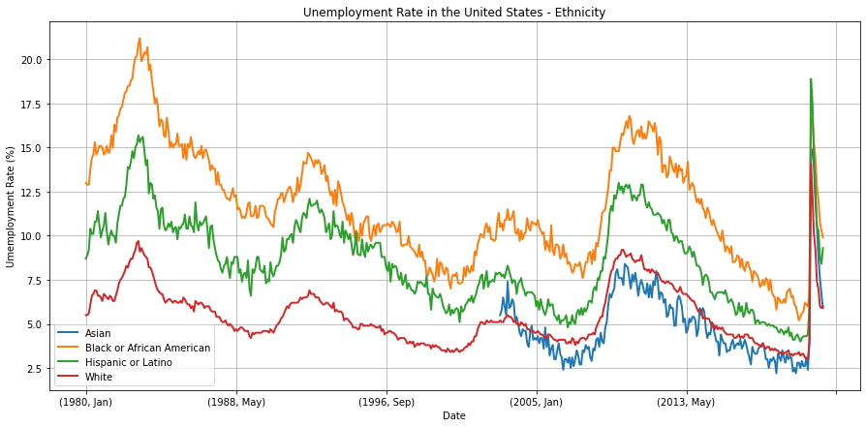
Hypothesis 2: Unemployment rate in the United States is independent of Ethnicity

Slide 5
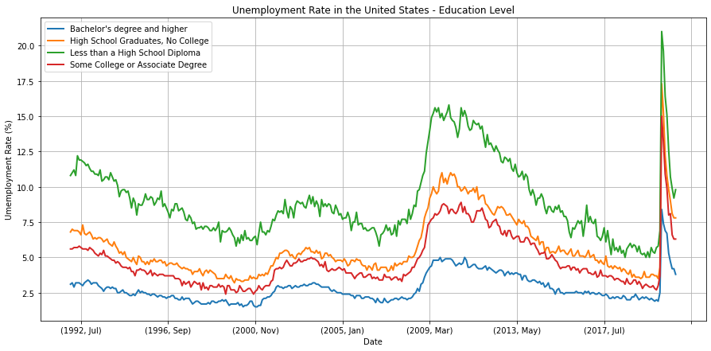
Hypothesis 3: Unemployment rate in the United States is independent of Education Level

Slide 6
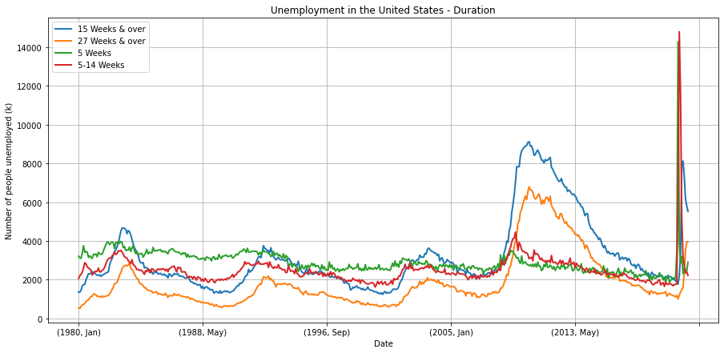
Hypothesis 4: Duration for which people are unemployed is independent of time

Slide 7
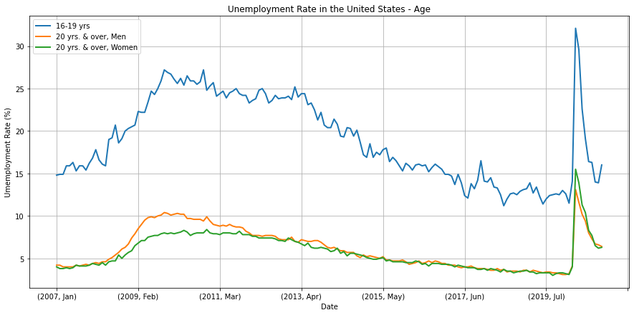
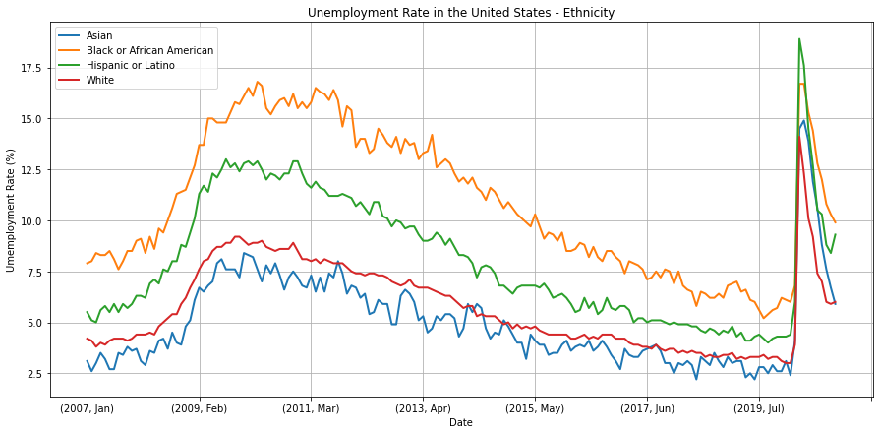
Analyzing Unemployment Rate in the United States with respect to Age and Ethnicity during the Great Recession and the Covid-19 pandemic

Slide 8
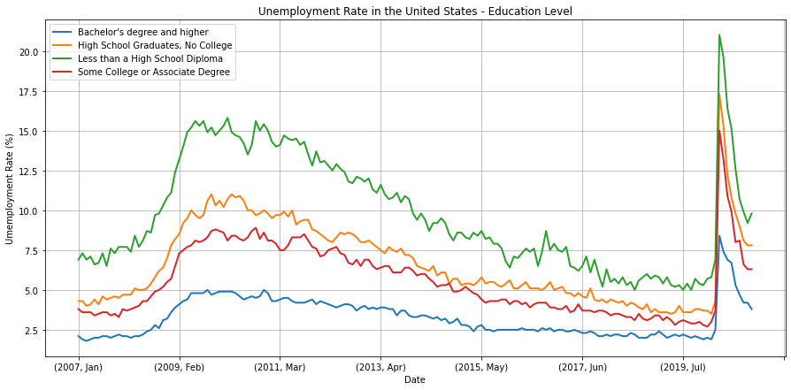
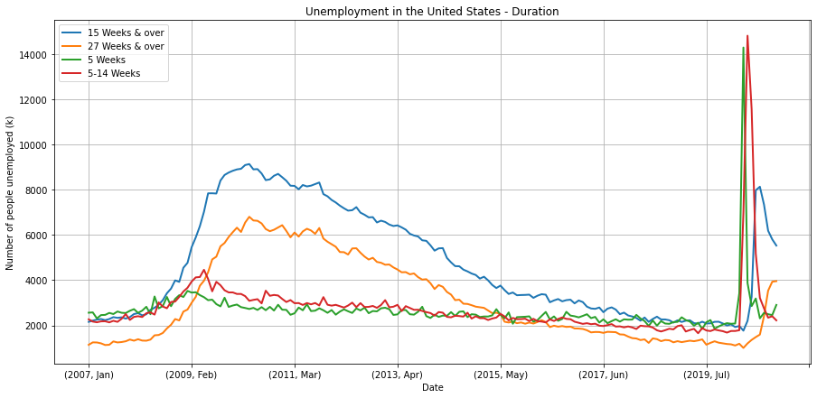
Analyzing Unemployment Rate in the United States with respect to Education Level and Duration during the Great Recession and the Covid-19 pandemic

Slide 9
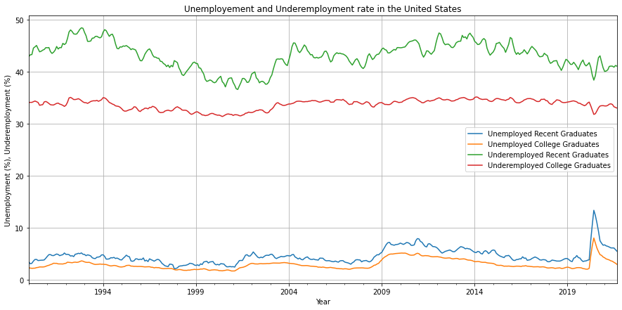
Hypothesis 5: Graduates in the United States prefer to be underemployed than staying unemployed

Slide 10
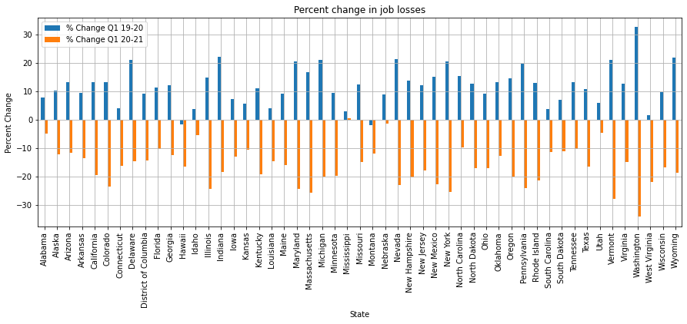
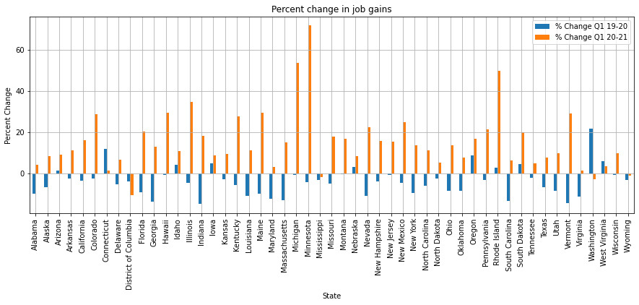
Hypothesis 6: Percent change in Job Losses and Job Gain during the Covid-19 pandemic is independent of the state

Slide 11
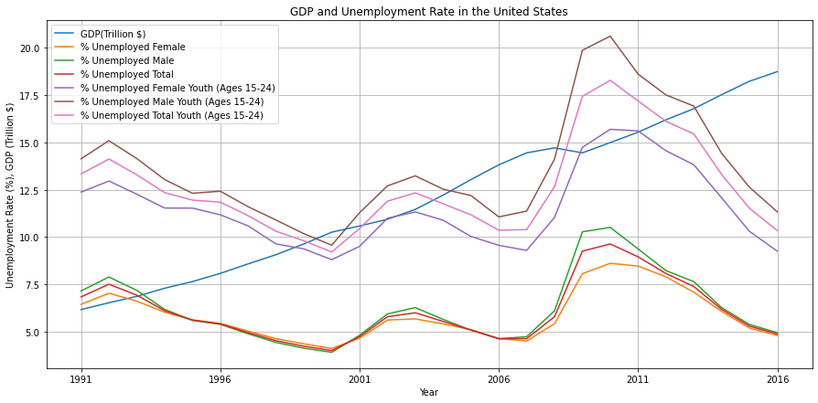
Hypothesis 7: There is no relationship between Gross Domestic Product (GDP) and Unemployment Rate

Slide 12
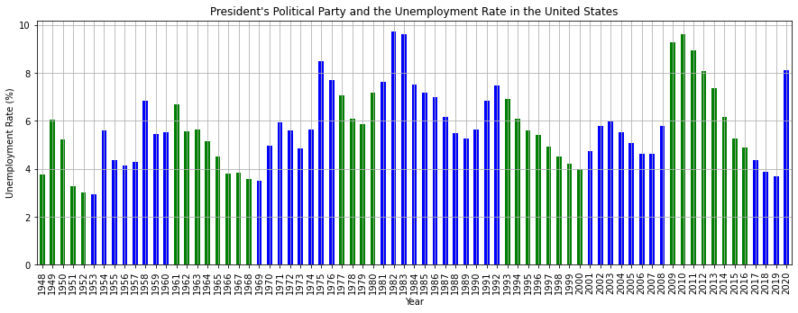
Hypothesis 8: There is no relationship between the President's Political Party and Unemployment Rate in the United States

Slide 13
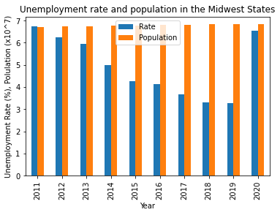
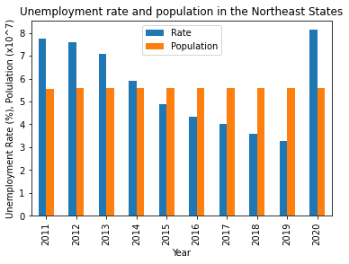
Hypothesis 9: There is no relationship between the population and the Unemployment Rate

Slide 14
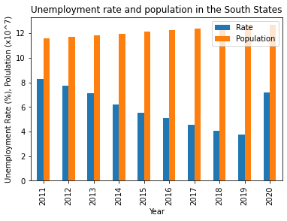
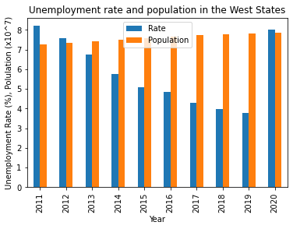
Hypothesis 9: There is no relationship between the population and the Unemployment Rate

Slide 15
Data Sources
https://data.bls.gov/cgi-bin/surveymost?ln
https://www.bls.gov/opub/ted/2021/job-gains-and-losses-by-state-from-march-2019-to-march-2021.htm
https://data.worldbank.org/indicator/NY.GDP.MKTP.CD?end=2020&locations=US&start=1960&view=chart
https://databank.worldbank.org/source/world-development-indicators%23
https://www.theguardian.com/news/datablog/2012/oct/15/us-presidents-listed#data
https://github.com/cphalpert/census-regions/blob/master/us%20census%20bureau%20regions%20and%20divisions.csv
https://www.census.gov/programs-surveys/popest/technical-documentation/research/evaluation-estimates/2020-evaluation-estimates/2010s-state-total.html
https://www.newyorkfed.org/research/college-labor-market/index.html#/overview
https://www.bls.gov/charts/state-employment-and-unemployment/state-unemployment-rates-animated.htm

Slide 16
Thank you

